Slide 1
Capstone Three Presentation “Predicting Stock Returns”
Thanh Nguyen

Slide 2
Introduction
Being able to predict stock returns means better trading decisions
Goal: at the end of trading today to predict returns tomorrow
Tools: traditional time series models (ARIMA), machine learning models
Stocks: Zions bank (ZION) and Fifth Third bank (FITB)
Notes:
Being able to predict stock returns leads to better trading and portfolio management decision.
If you predict going up you can buy; goes down you sell.
Even better, if you don’t have money to buy or no stock to sell => you could sell short the stock you predicted to goes down, take the proceeds to buy the stock you think will goes up => you make money without having money.
At the end of today, we have such and such information, we need to predict return.
Explain why we choose these two stocks. ZION rank about 700 and FITB 300 by market cap.

Slide 3
Key takeaways and agenda
Key takeaways
Achieved marginal improvement compared to naïve model
KNN models show potential to predict direction of price movement
Agenda
Data source
Exploratory data analysis (EDA)
Target, features, correlation analysis
Modeling and performance on unseen data
Conclusion
Future work

Slide 4
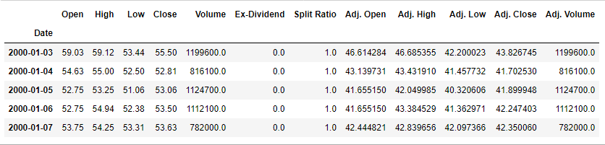
Data source
Nasdaq Data Link, WIKI Prices database
3000 US stocks (prices, dividends, splits)
Coverage ends March 2018.
High-quality data, no need for data wrangling
Notes:
We will use daily data and we will use adj close to calucalte returns.
No missing data => no need for data wrangling

Slide 5
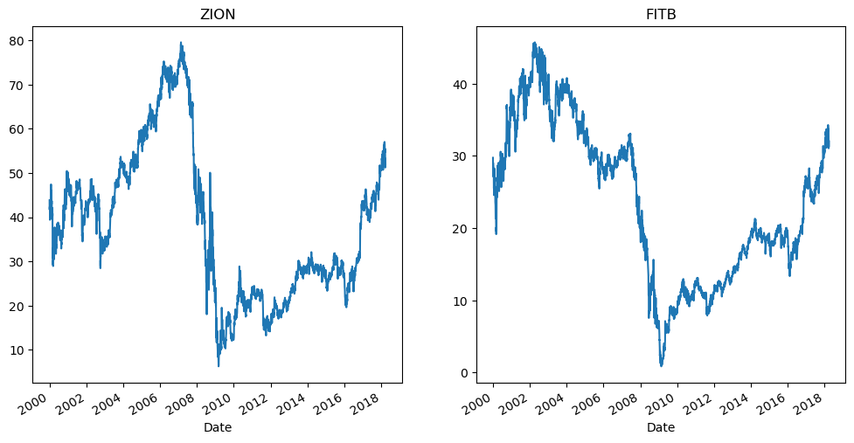
Data source
ZION and FITB Prices

Slide 6
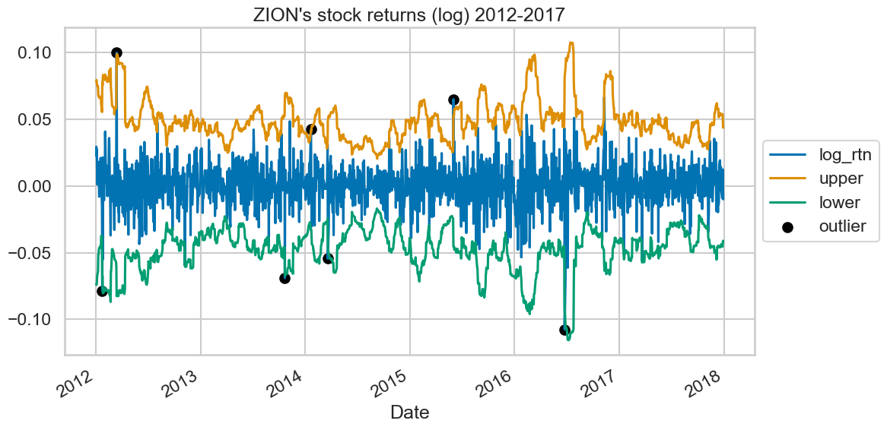

EDA: Target (log returns)
$${log_rtn⁡}_{t}=log⁡(\frac{P_{t}}{P_{t−1}})$$
Series is stationary
Augmented Dickey-Fuller test (ADF), Kwiatkowski-Phillips-Schmidt-Shin test (KPSS).
Notes:
Previose graph show nonstationarity => we will work with return
Log returns is more preferred than simple return.

Slide 7
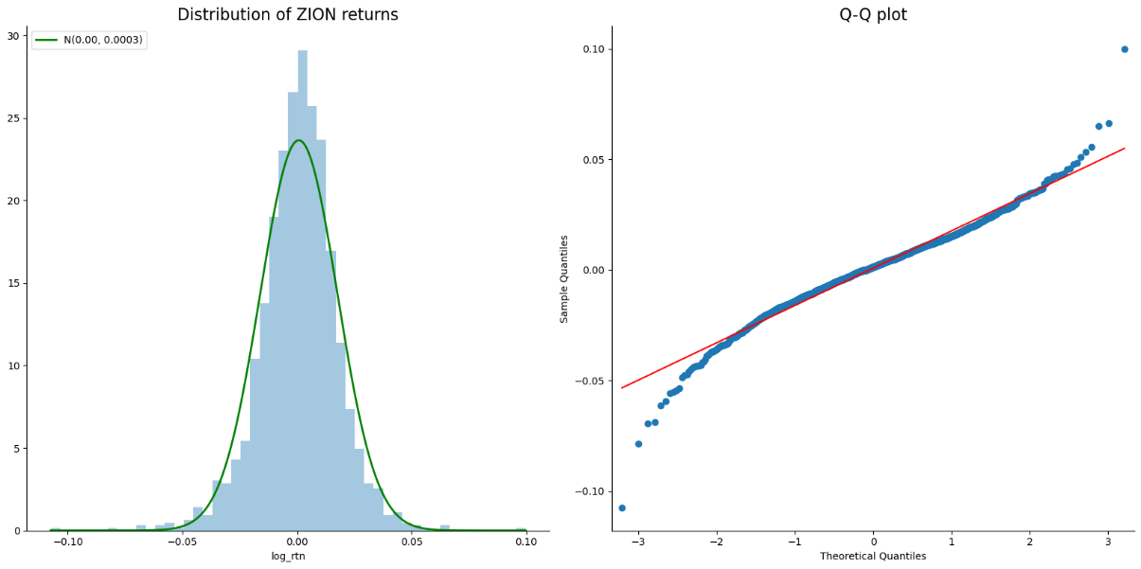
EDA: Target (log returns)

Slide 8
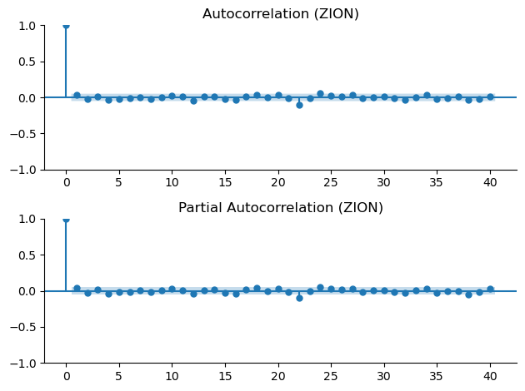
EDA: Target (log returns)

Slide 9
EDA: Features
Lag0 to lag14 of returns
Features based on trading volume
Today’s one-day change in trading volume
10-day moving average of trading volume change
Technical analysis indicators
Moving average (14-day, 50-day, and 200-day)
Relative strength index (14-day, 50-day, and 200-day)
Features based on time
Month of the year (sine and cosine transformation)
Notes:
Traidional ts model use past returns to predict future return s => no need any features.
For ARIMAX and machine learning => additional features.
We predict tomorrow stock return: lag0 is today return.
4 groups of features

Slide 10
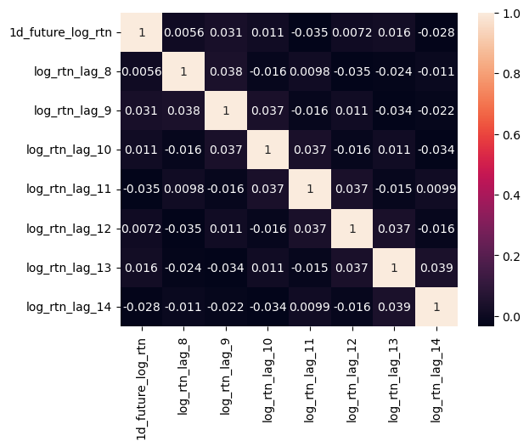
EDA: Correlation analysis

Slide 11
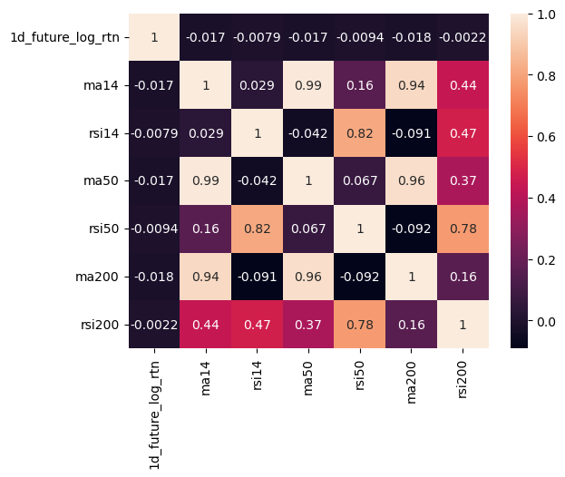
EDA: Correlation analysis
Notes:
High correlation
We will use only ma50 and rsi50

Slide 12
Modeling
Performance measure: Mean Squared Error (MSE)
Mean Absolute Percentage Error (MAPE) not preferred
3-year and 5-year training period for all models
ARIMA (p, d, q)
p and q: from 0 to 4
d: 0 or 1
Machine learning models: tune corresponding hyperparameters
Notes:
Step1 = GridSearchCV to find best hyperparamenters. ROC_AUC as performance measure.
Step2 =
Step3 = refit best model using all Train set, and measure performance on Test set.

Slide 13
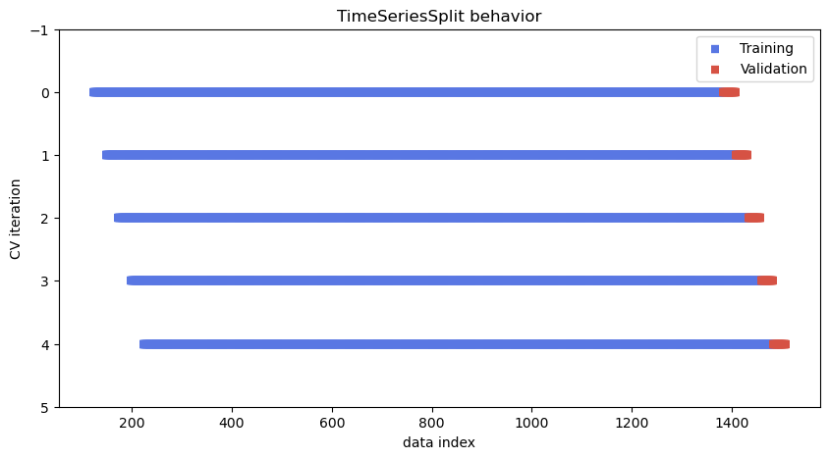
Modeling
Train set: daily returns 2012-2017
Test set: first 25 trading days of 2018
Cross validation: TimeSeriesSplit()
Train set: 1260 trading days (5 years) or 756 (3 years)
Validation set: 25 trading days
Notes:
Explain x-axis and y-axis

Slide 14
Hyperparameter Tuning for ZION Prediction
Model Name | Best Parameters | Cross-Validation Score (mse)
Random Forest | 'max_depth’: 1 'max_features': 0.1 'n_estimators': 500 | 0.000172
Gradient Boosting | 'learning_rate': 0.005 'max_depth': 6 'max_features': 0.1 'min_samples_split': 8 'n_estimators': 50 'subsample': 0.8 | 0.000171
Ridge | alpha: 7250 | 0.000172
KNN | n_neighbors: 14 | 0.000185
KNN (include month sine and cosine) | n_neighbors: 16 | 0.000177
ARIMA | (4, 1, 3) | 0.000172
Notes:
Ridge and KNN data is scaled.
We can not use month sine and cosine in tree-based algorithm because tree-base model uses one feature at a time; but we need both sine and cosine to uniquely identify a month.
Using 5-year training period is better than 3-years => could use longer period to train?

Slide 15
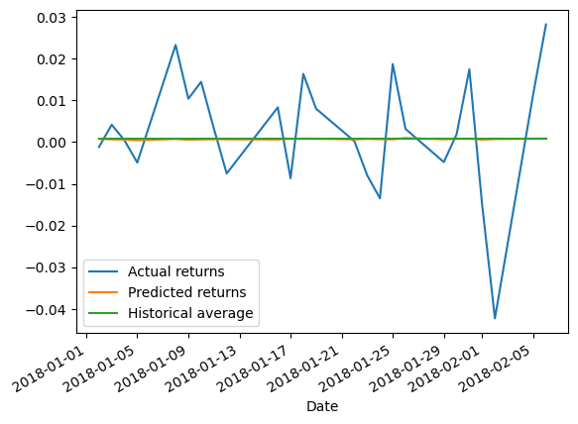
Performance on unseen data (ZION)
 | Best model performance |  | Naïve model performance
 | MSE | R-square | MSE | R-square
Predicting ZION returns | 0.0002087 | -1.35% | 0.0002092 | -1.60%
Notes:
Explain x-axis and y-axis
Plot can show our best model is almost nothing better than random walk with drift (return = historical average)

Slide 16
Hyperparameter Tuning for FITB Prediction
Model Name | Best Parameters | Cross-Validation Score (mse)
Random Forest | 'max_depth’: 20 'max_features': 0.1 'n_estimators’: 100 | 0.000128
Gradient Boosting | 'learning_rate': 0.08 'max_depth’: 3 'max_features': 0.1 'min_samples_split’: 6 'n_estimators': 50 'subsample’: 1 | 0.000129
Ridge | alpha: 40000 | 0.000130
KNN | n_neighbors: 11 | 0.000132
KNN (include month sine and cosine) | n_neighbors: 6 | 0.000128
ARIMA | (1, 0, 2) | 0.000131
Notes:
- Ridge and KNN data is scaled

Slide 17
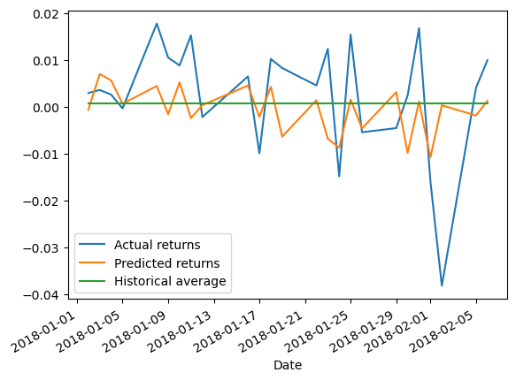
Performance on unseen data (FITB)
 | Best model performance |  | Naïve model performance
 | MSE | R-square | MSE | R-square
Predicting FITB returns | 0.000147 | 1.28% | 0.000152 | -2.12%

Slide 18
Conclusion
Achieved marginal improvement compared to naïve model
Not enough to be usable
KNN models show potential to predict direction of price movement
Can develop trading strategy based on this signal and carry out back testing
Notes:
-

Slide 19
Future Work
ARIMA with seasonality and exogenous features
Overfitting of Random Forest
Neural network models (RNN)
Gradient Boosting converge to historical average (ZION)
Longer training period (longer than 5 years)

Slide 20
References
Lewinson, E. 2022. Python for Finance Cookbook. <packt>

